Slide 1
IBM University Engagement Project Submission
“Exploring the Power of Agentic AI with IBM Granite and IBM Bob”

Slide 2
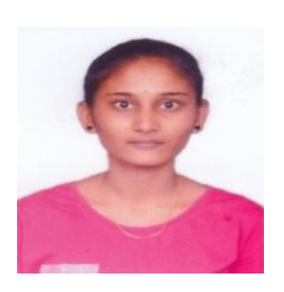
Project Tile – : AI Agent for Smart Farming Advice
Domain of Project – Agricultural Technology (Agri Tech)
Student Name | Recent Passport Photo | Email ID | Mobile number [WhatsApp]
Merugu Revathi |  | revathimerugu30@gmail.com | 8179337128
Recommended font style and size:
Font Style: Arial
Font Size (Heading): 28
Font Size (Content): 20

Slide 3
Problem Statement -
AgriGenius: AI Agent for Smart Farming Advice using IBM watsonx.ai, Granite & RAG
The Challenge
Small-scale farmers often face difficulties in making timely and informed agricultural decisions due to limited access to reliable and localized farming information. Essential details such as weather forecasts, soil conditions, suitable crop selection, pest and disease management, irrigation planning, fertilizer recommendations, and current market prices are often scattered across multiple sources and are difficult to understand.
Most farmers depend on traditional practices or local advice, which may not always be accurate or suitable for changing climatic conditions. This lack of personalized and data-driven guidance results in poor crop selection, inefficient resource utilization, reduced productivity, financial losses, and increased farming risks.
The Objective
Develop an AI-powered Smart Farming Agent that provides real-time, localized, and trustworthy agricultural guidance using IBM watsonx.ai and Granite Models.
The solution should:
Recommend suitable crops based on soil, season, and weather.
Analyze soil information and provide fertilizer recommendations.
Detect crop diseases from uploaded images.
Provide pest management suggestions.
Retrieve real-time weather forecasts.
Display current mandi/market prices.
Support multilingual conversations.
Use Retrieval-Augmented Generation (RAG) for trusted agricultural knowledge.

Slide 4
Proposed Solution -
The proposed solution is an intelligent multi-agent Smart Farming Assistant developed using Python Flask, IBM watsonx.ai, IBM Granite Models, and Retrieval-Augmented Generation (RAG).
The AI assistant combines trusted agricultural knowledge with IBM Granite reasoning capabilities to deliver personalized farming recommendations.
The system includes multiple intelligent agents:
Crop Recommendation Agent
Soil Intelligence Agent
Weather Advisory Agent
Pest Detection Agent
Market Price Agent
Farming Knowledge Agent
The solution retrieves verified agricultural information from government datasets, weather services, agricultural manuals, and market databases using RAG before generating responses with IBM Granite Models.
Farmers interact through an intuitive multilingual chat interface that supports both text and image-based queries.

Slide 5
Technology Used
Python Flask – Backend web application
IBM watsonx.ai – AI model deployment
IBM Granite Models – AI reasoning & recommendations
IBM Cloud Lite – Cloud infrastructure
RAG – Trusted knowledge retrieval
FAISS – Vector database for RAG
Sentence Transformers – Document embeddings
SQLite – Farmer & application data
HTML, CSS, JavaScript – Frontend development
OpenCV & Pillow – Soil/Crop image processing

Slide 6
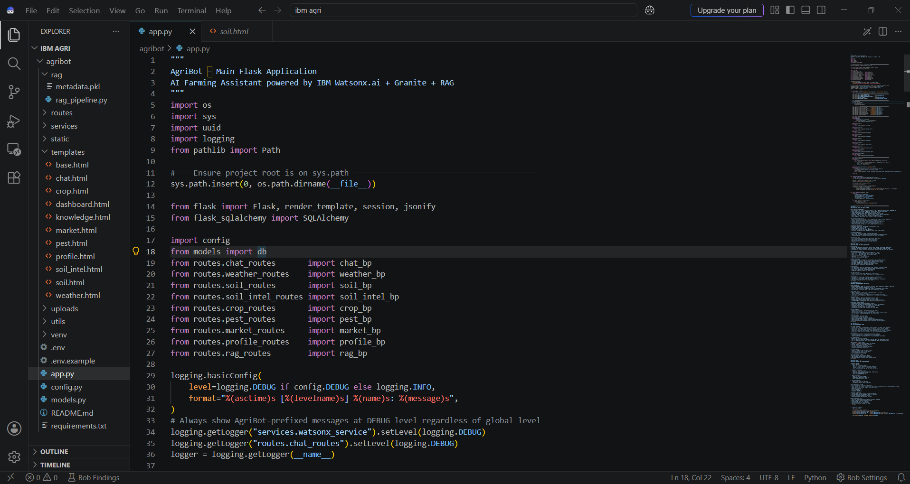
Required Files created using IBM bob -
HTML
Requirements.txt
Style.css
.env
Requirement.txt

Slide 7
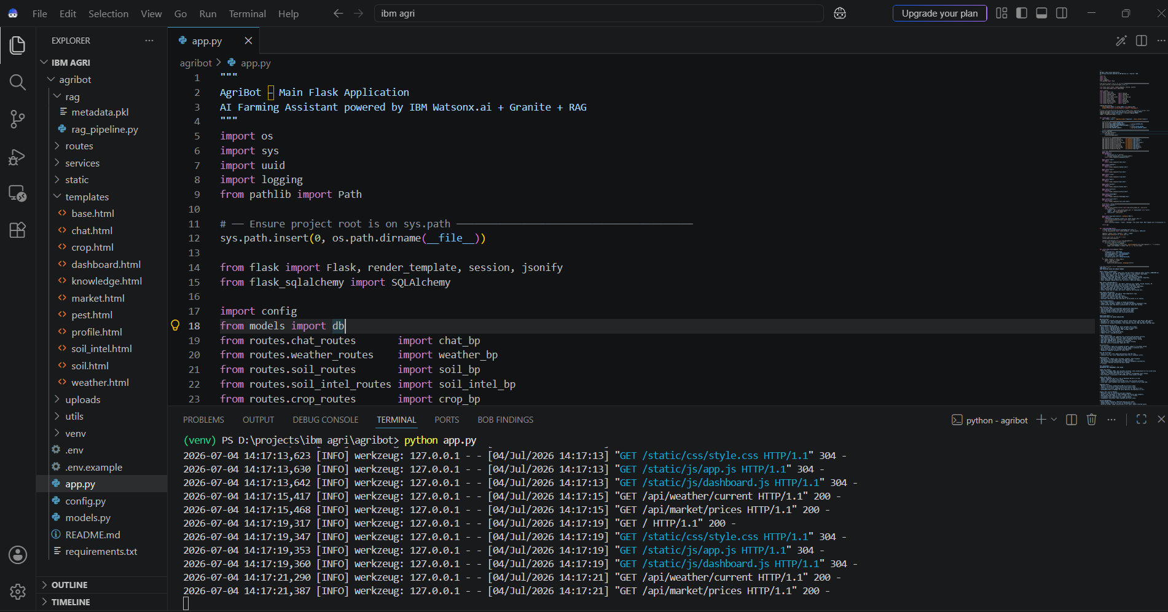
IBM Bob Screenshots:

Slide 8
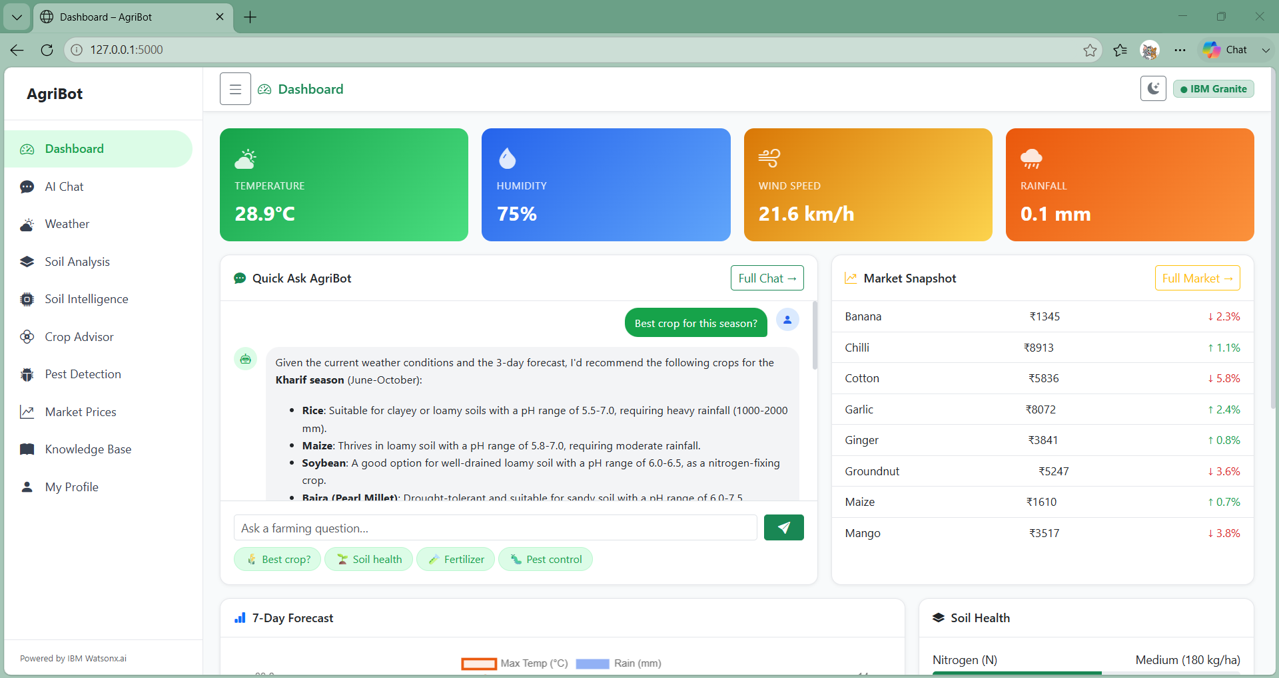
User Interface of AI-Powered Smart Farming Advisor

Slide 9
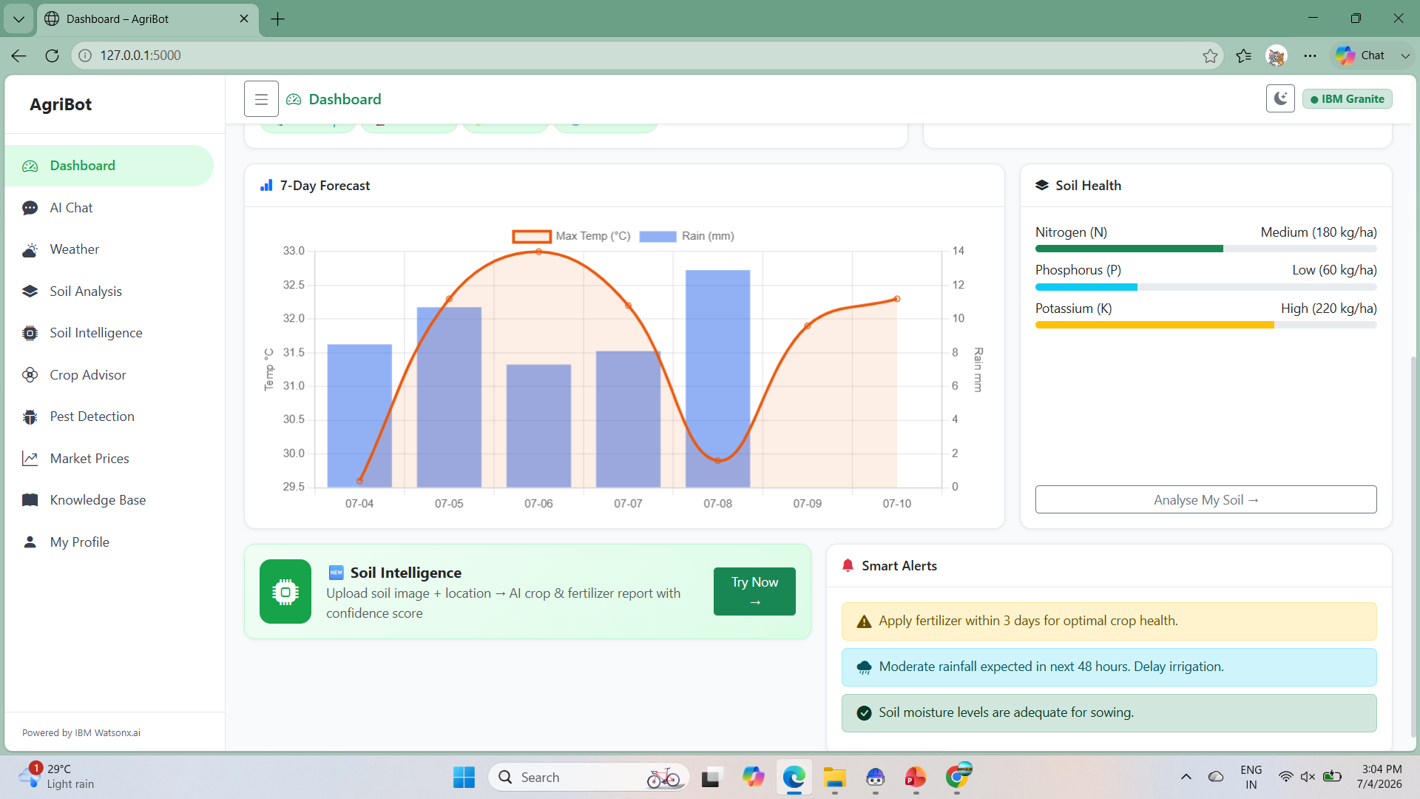
User Interface of AI-Powered Smart Farming Advisor

Slide 10
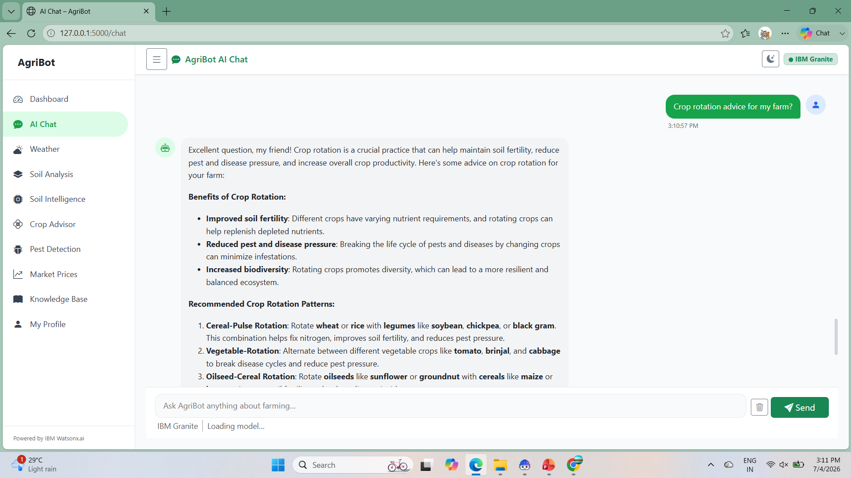
AgriBot AI Chat Interface (IBM Granite Powered)

Slide 11
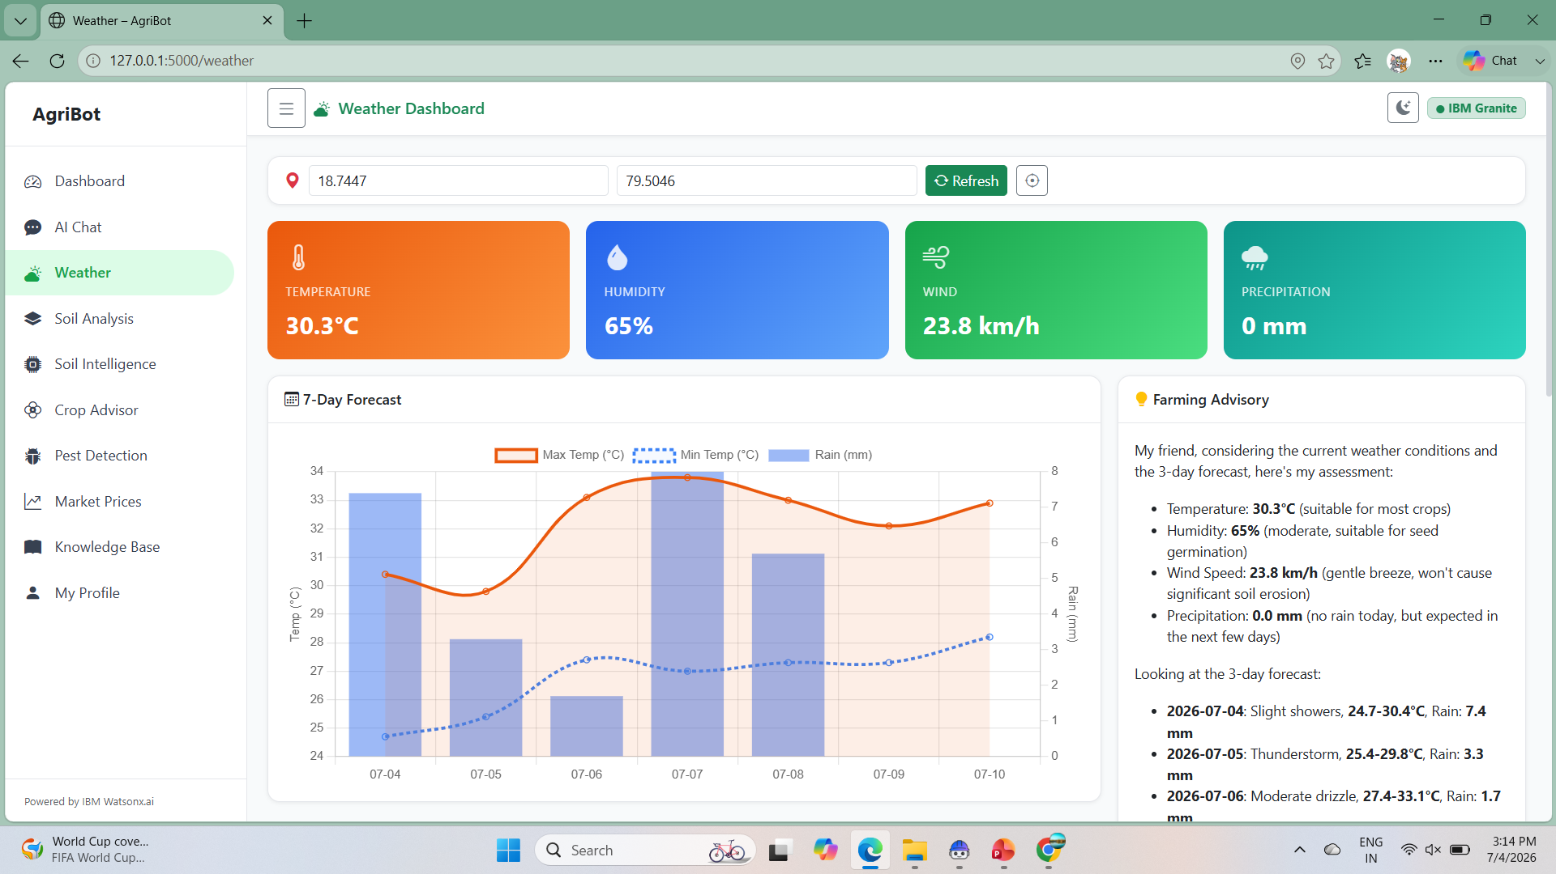
AgriBot Weather Advisory Dashboard

Slide 12
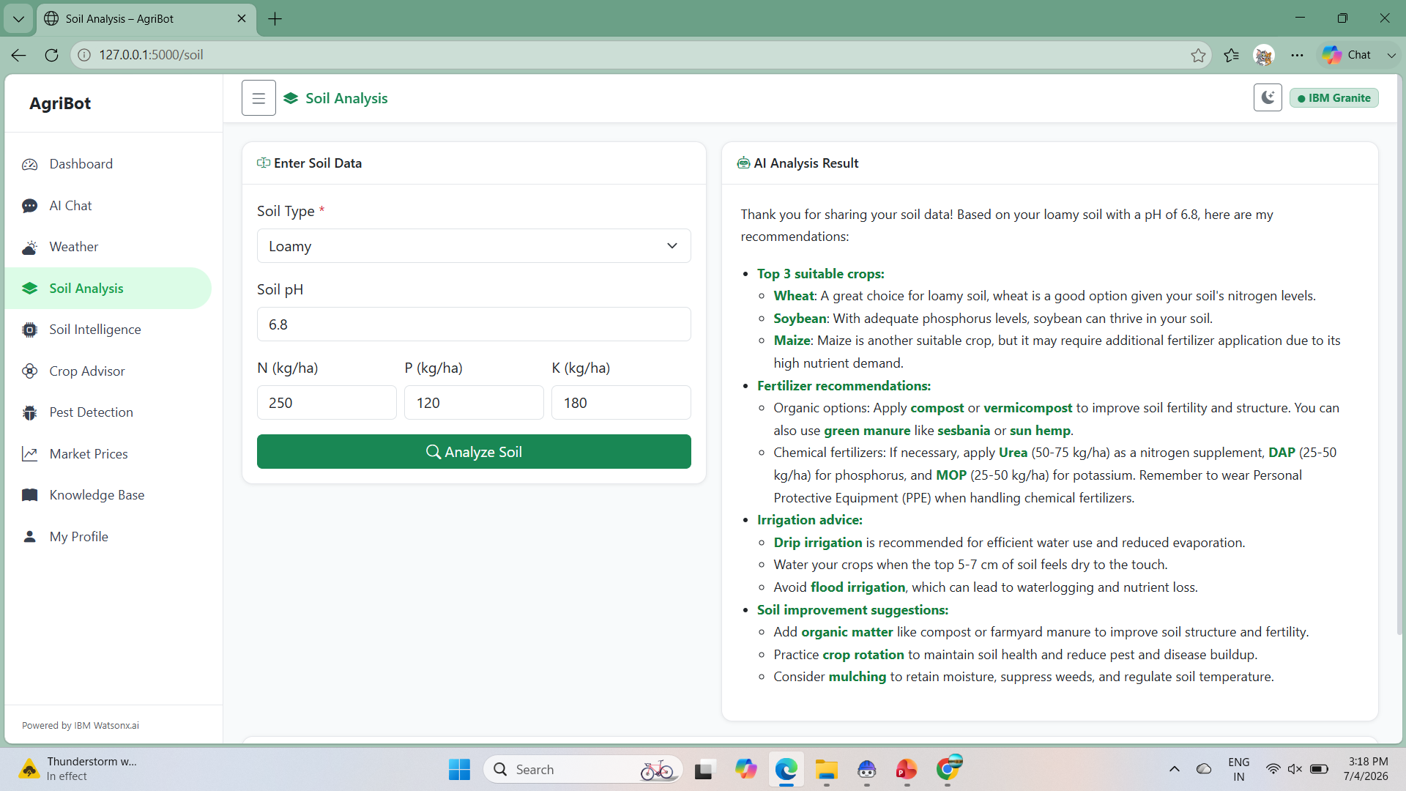
AI-Based Soil Analysis & Crop Recommendation

Slide 13
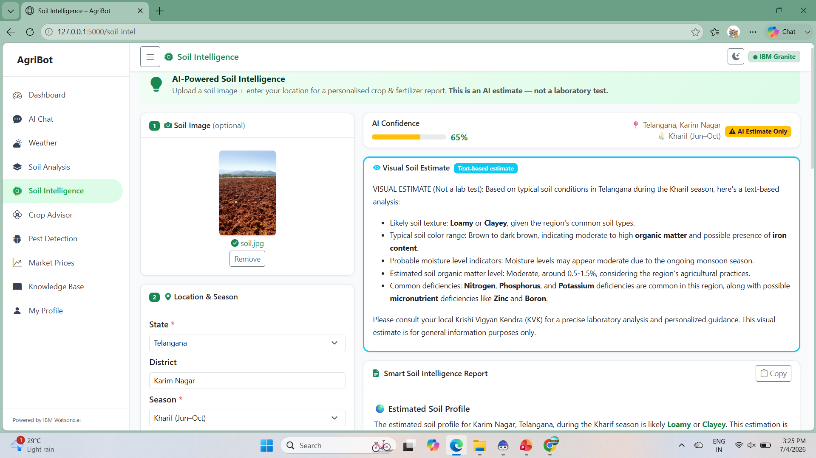
AI-Powered Soil Intelligence & Crop Recommendation

Slide 14
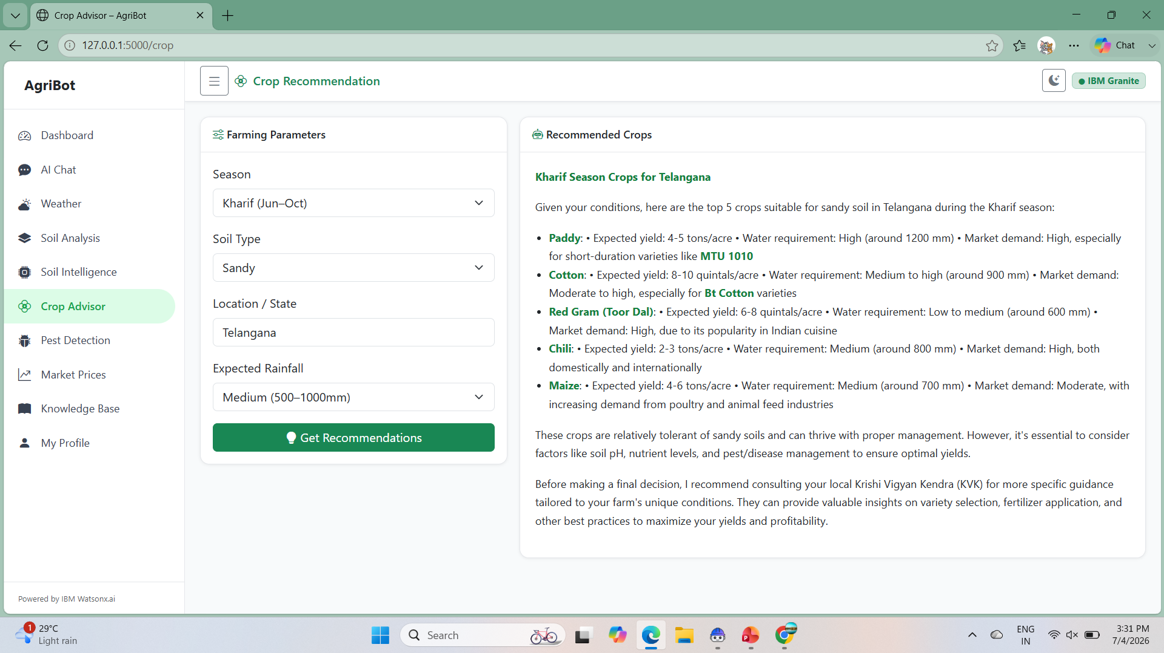
AI-Powered Crop Recommendation

Slide 15
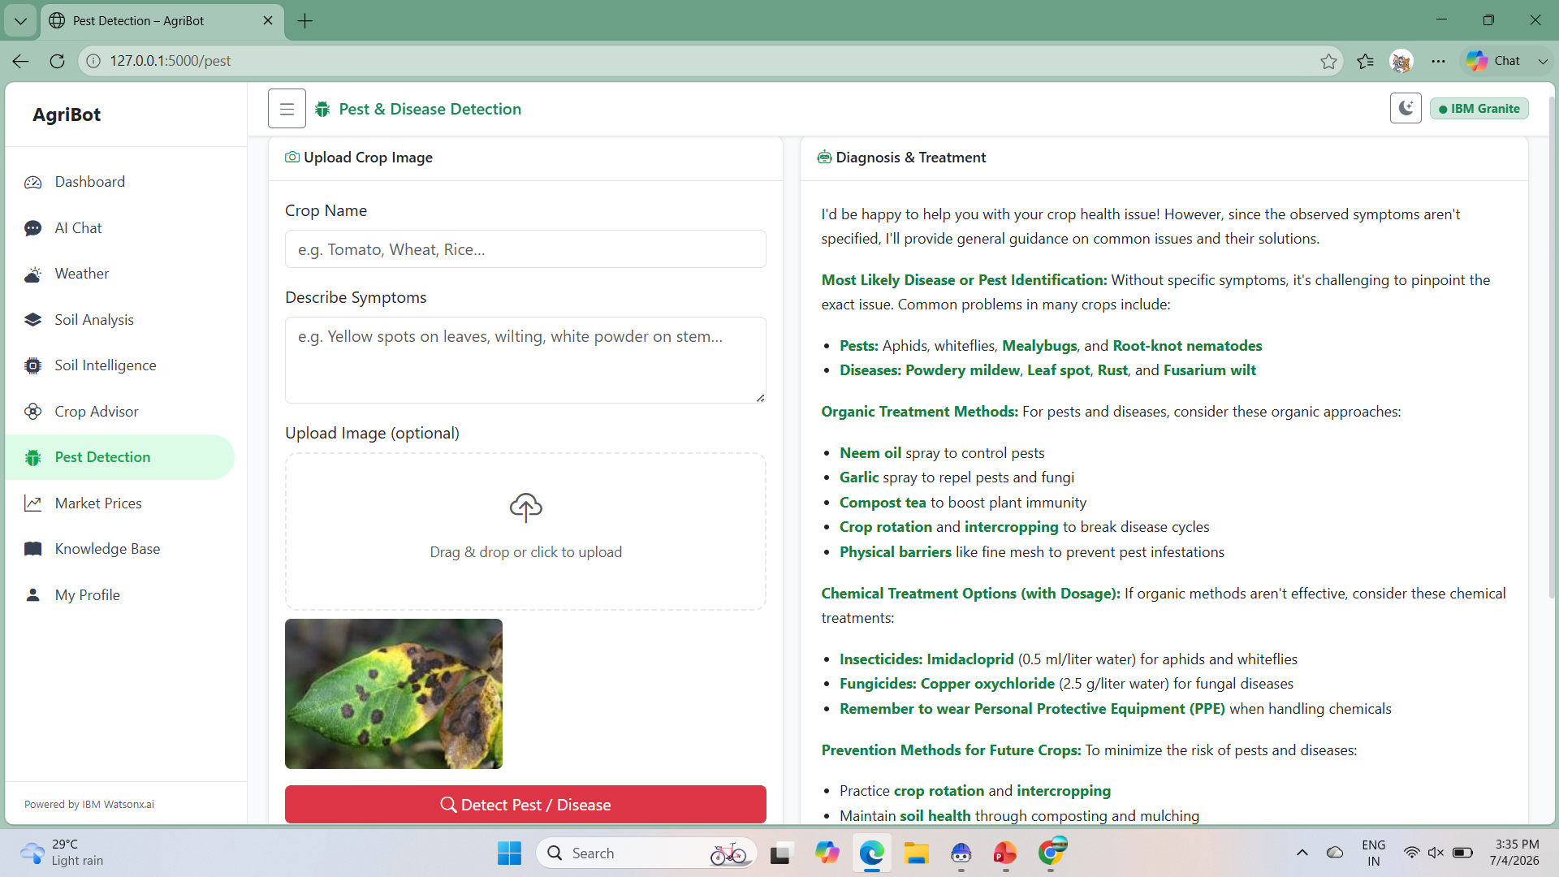
AI-Based Pest & Disease Detection

Slide 16
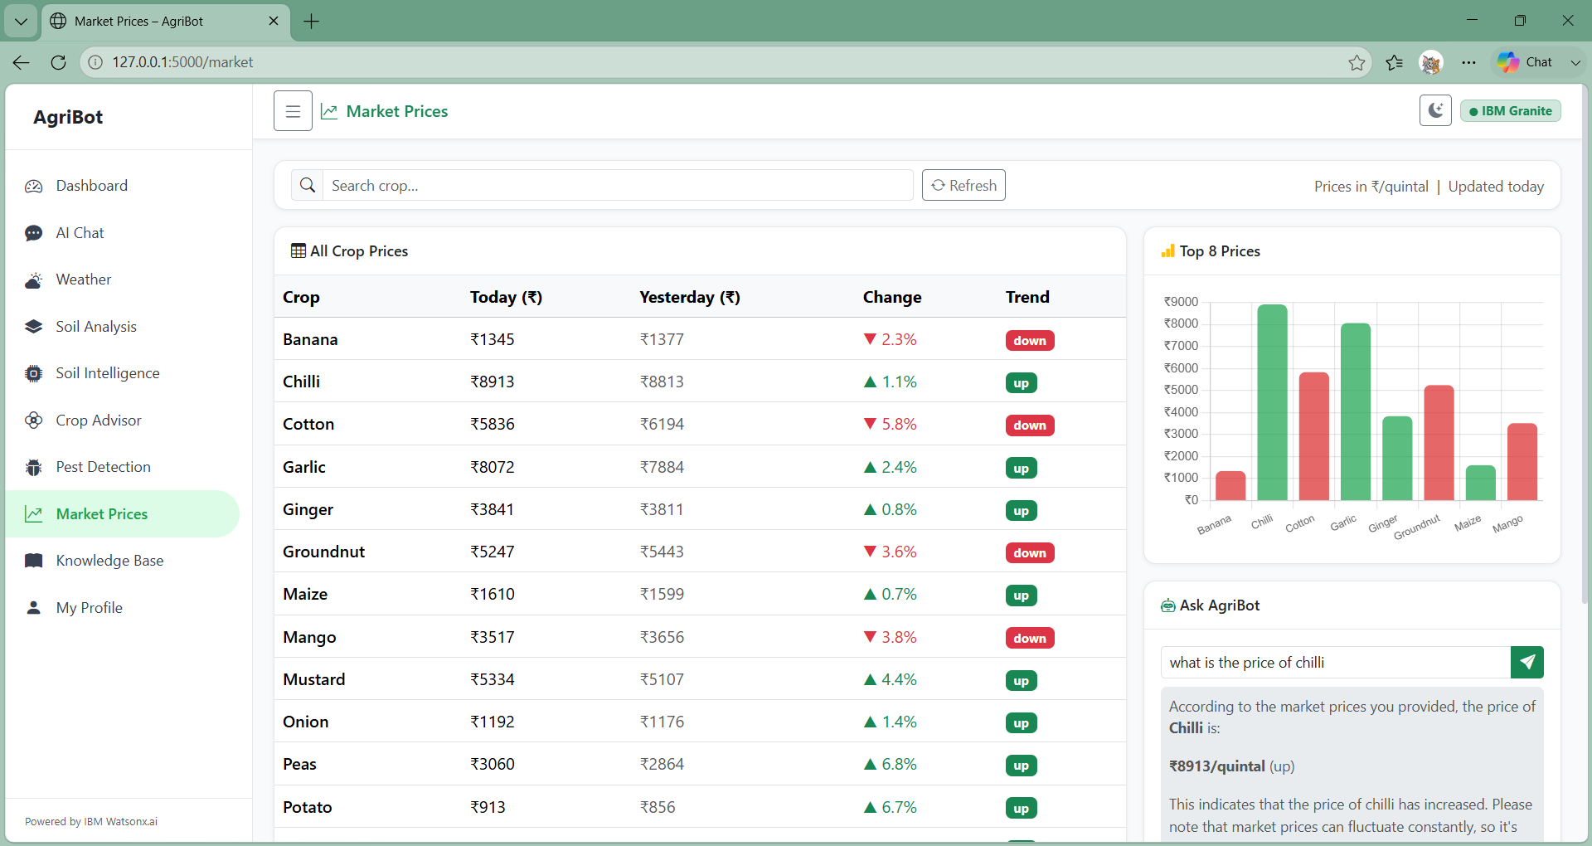
AI-Powered Market Price Analysis

Slide 17
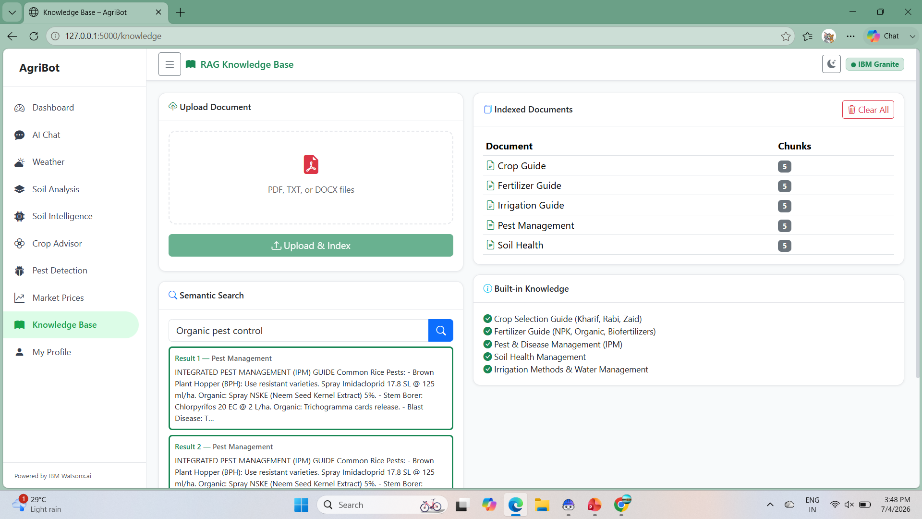
RAG-Based Agricultural Knowledge Base

Slide 18
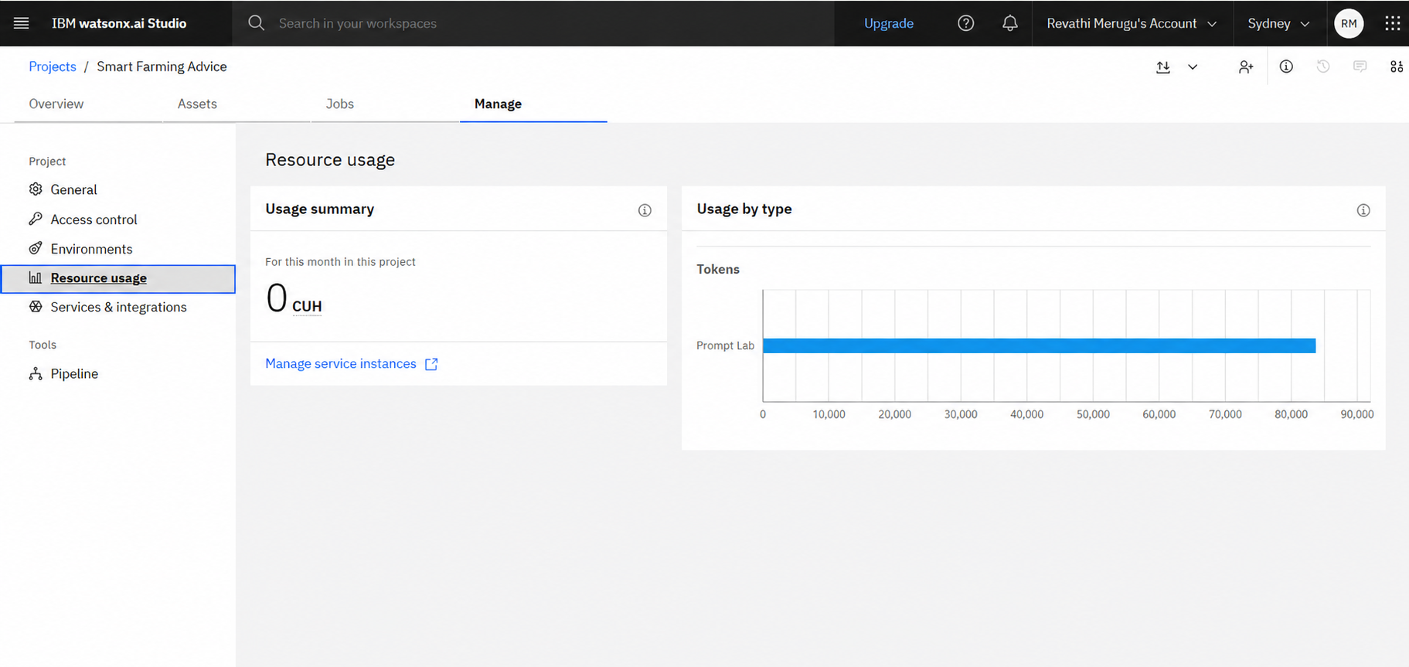
AI Agent for Smart Farming Advice

Slide 19
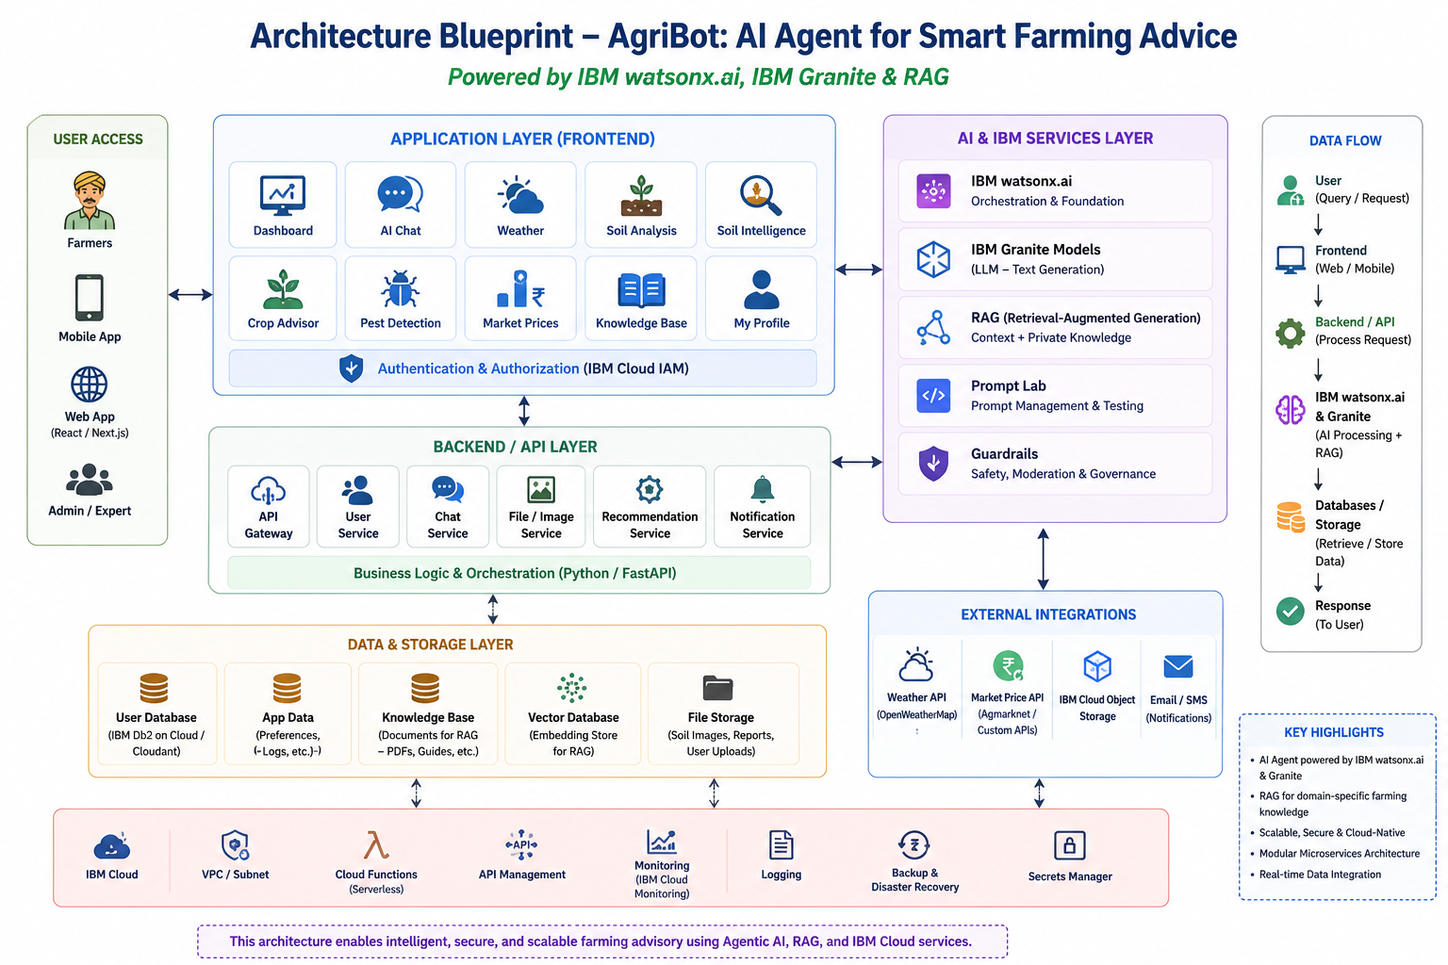
Architecture blueprint for IBM bob:

Slide 20

Role of Agentic AI in the solution
Agentic AI enables AgriBot to autonomously understand farmer queries, retrieve trusted agricultural knowledge using RAG, and generate personalized recommendations with IBM Granite Models.
The AI agent performs multiple intelligent tasks, including:
Recommends suitable crops based on soil type, season, and location.
Analyzes soil data and uploaded soil images to estimate soil health.
Detects crop pests and diseases and suggests appropriate treatments.
Provides weather-based farming advice and sowing recommendations.
Retrieves market prices to help farmers make better selling decisions.
Uses RAG to search agricultural documents and deliver reliable, context-aware answers.
Supports sustainable farming through fertilizer, irrigation, and organic farming recommendations.

Slide 21
Novelty and Uniqueness
AI-Powered Smart Farming Assistant using IBM watsonx.ai & Granite Models.
RAG-Based Knowledge Retrieval for trusted and context-aware agricultural guidance.
Soil Image + Location-Based Crop Recommendation – Farmers upload a soil image and provide their location (State/District); the AI estimates soil characteristics and recommends suitable crops, fertilizers, irrigation methods, and organic farming practices.
Personalized Crop Recommendation based on soil type, season, weather, and regional conditions.
AI Soil Intelligence with soil health analysis and fertilizer suggestions.
AI-Based Pest & Disease Detection with treatment and prevention recommendations.
Weather-Based Farming Advisory for sowing and irrigation planning.
Real-Time Market Price Dashboard for better selling decisions.
Responsive AI Dashboard with multilingual chat support and an easy-to-use interface.
Powered by IBM Cloud Lite, IBM Granite & watsonx.ai for secure and scalable AI services.

Slide 22
Git Hub Link
https://github.com/Revathimerugu30/AI-Agent-for-Smart-Farming-Advice
1. Generative AI in Action Credly Certificate
2. IBM BOB Certificate
3. PPT
4. Problem Statement
·
·

Slide 23
Future Scope
Integration with real-time satellite imagery for crop monitoring.
Support for IoT sensors to monitor soil moisture, temperature, and humidity.
Drone-based crop health monitoring for large-scale farms.
Voice-enabled multilingual assistant for regional language support.
Government scheme and subsidy recommendations.
Smart irrigation recommendations for efficient water management.
Development of an Android/iOS mobile application with offline support.
·
·
·

Slide 24
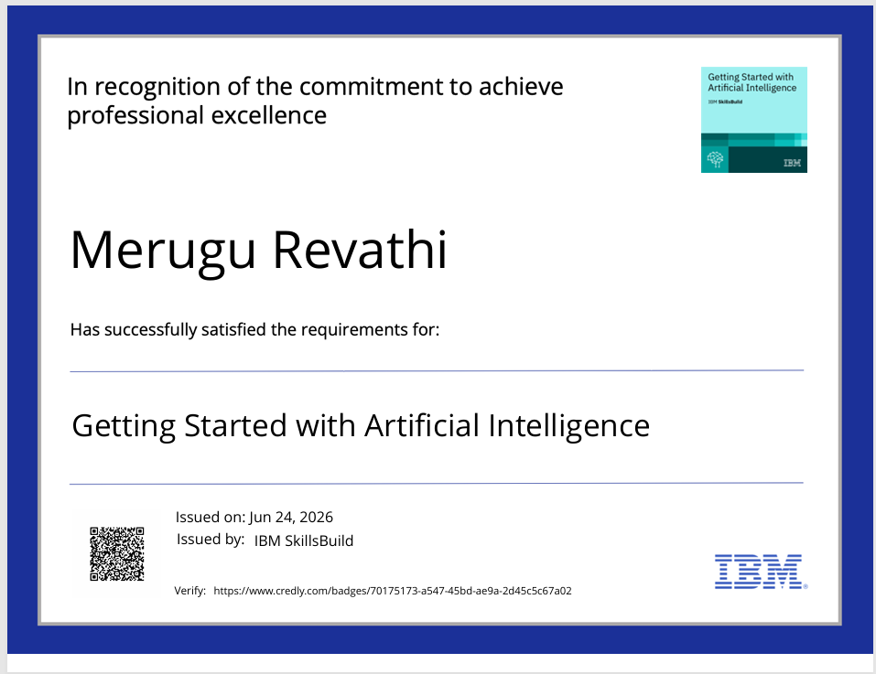
Certificates Earned:
Please add your credly certificate

Slide 25
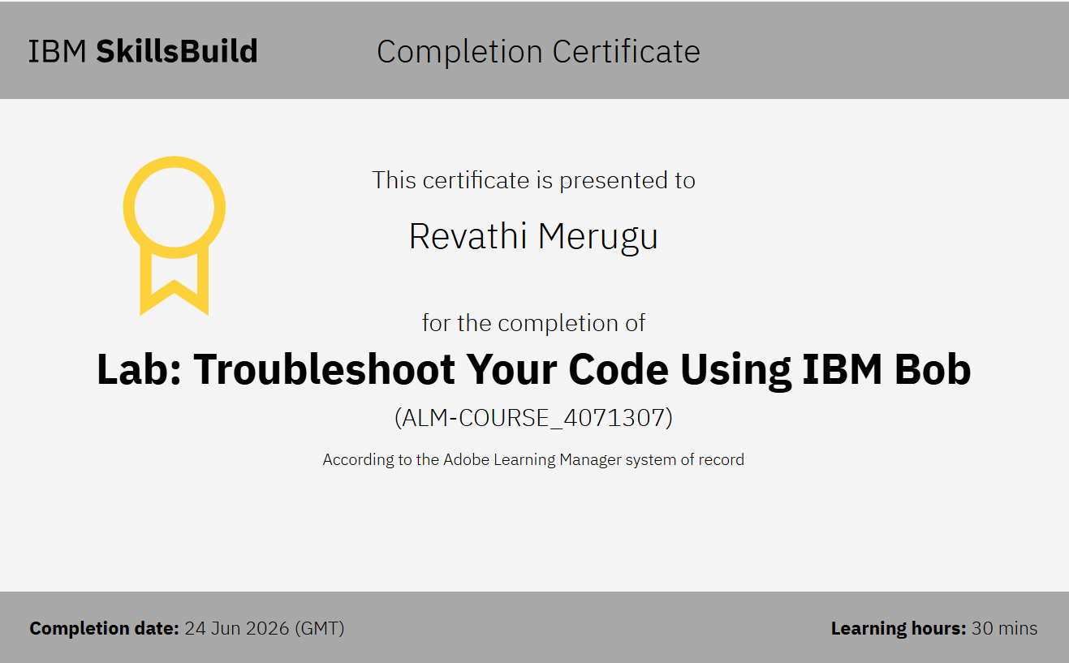
Certificates Earned:​
Add your IBM BOB Certificate

Slide 26
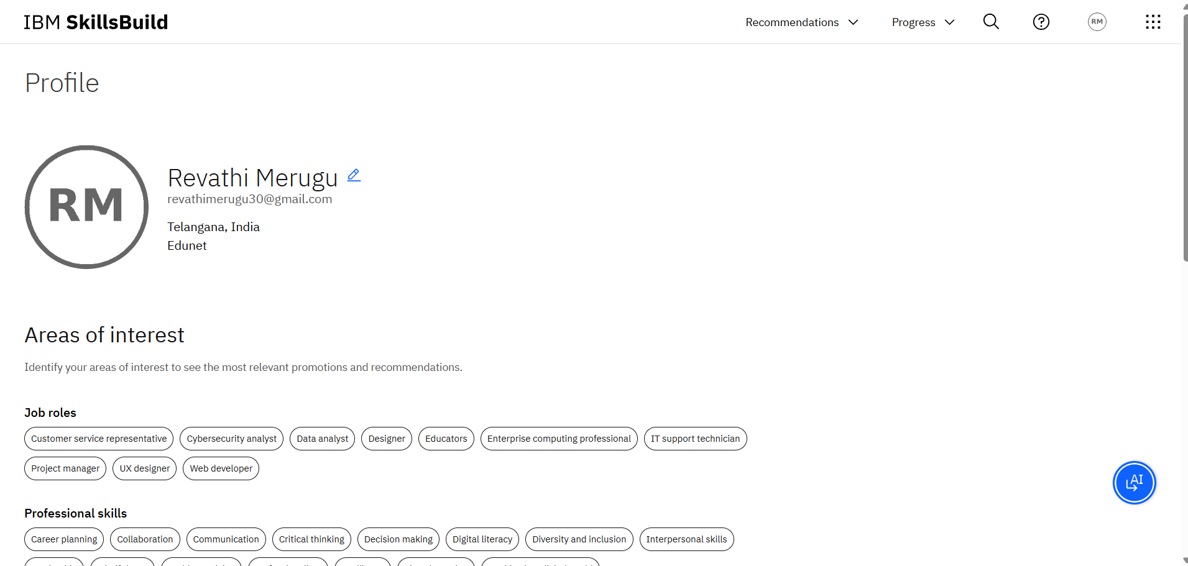
IBM SKILLSBUILD PROFILE

Slide 27


